Slide 1
Programming Concepts

Slide 2
Basic concept of logic
Programming logic, at its core, involves the development of systematic procedures that solve specific problems.
Logical programming isn’t about the syntax of a particular programming language. Rather, it’s about the approach to solving a problem and how developers use their chosen logic language programming tool to achieve this.

Slide 3
Whether you’re coding in Java, Python, or C++, the essence of coding logic remains the same. It encompasses:
Sequence: The order in which instructions are executed.
Selection: Decision-making with if-else statements, switch-case statements, etc.
Loop: Repeating certain actions using for, while, and do-while loops.
Function: Group of reusable code which can be called anywhere in the program.
These concepts form the cornerstone of any programming logic and act as the building blocks for creating software applications.

Slide 4
Structure of a program
The sections of a C program are listed below:
Documentation section
Preprocessor section
Definition section
Global declaration
Main function
User defined functions

Slide 5
Documentation section
It includes the statement specified at the beginning of a program, such as a program's name, date, description, and title. It is represented as:
//name of a program
/*
Overview of the code
*/
Both methods work as the document section in a program. It provides an overview of the program. Anything written inside will be considered a part of the documentation section and will not interfere with the specified code.

Slide 6
Preprocessor section
The preprocessor section contains all the header files used in a program. It informs the system to link the header files to the system libraries. It is given by:
#include<stdio.h>
#include<conio.h>

Slide 7
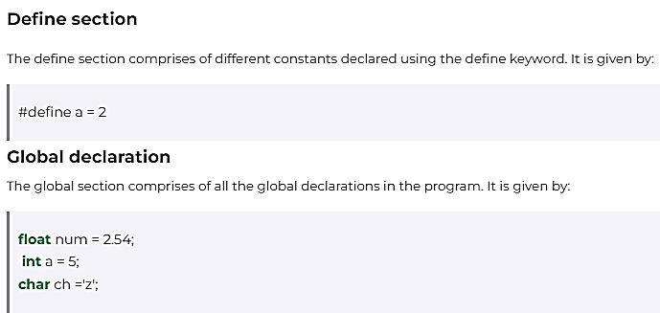

Slide 8
Main function
main() is the first function to be executed by the computer. It is necessary for a code to include the main().
It is like any other function available in the C library.
Parenthesis () are used for passing parameters (if any) to a function.
main()
int main()
void main()

Slide 9
User defined functions
The user defined functions specified the functions specified as per the requirements of the user. For example, color(), sum(), division(), etc.

Slide 10
Conditional statements
Write a program to find maximum between two numbers.
Write a program to find maximum between three numbers.
Write a program to check whether a number is negative, positive or zero.
Write a program to check whether a number is divisible by 5 and 11 or not.
Write a program to check whether a number is even or odd.
Write a program to input marks of five subjects Physics, Chemistry, Biology, Mathematics and Computer. Calculate percentage and grade according to following: Percentage >= 90% : Grade A Percentage >= 80% : Grade B Percentage >= 70% : Grade C Percentage >= 60% : Grade D Percentage >= 40% : Grade E Percentage < 40% : Grade F

Slide 11
Loop Control statements
Using loops in Python automates and repeats the tasks in an efficient manner.
But sometimes, there may arise a condition where you want to exit the loop completely, skip an iteration or ignore that condition.
These can be done by loop control statements. Loop control statements change execution from their normal sequence.

Slide 12
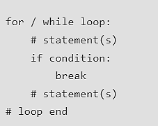
Break
The break statement in Python is used to terminate the loop or statement in which it is present.
After that, the control will pass to the statements that are present after the break statement, if available.
If the break statement is present in the nested loop, then it terminates only those loops which contain the break statement.

Slide 13
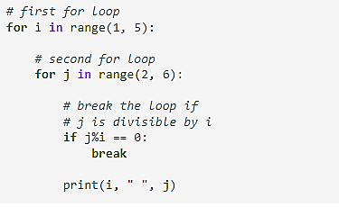

Slide 14
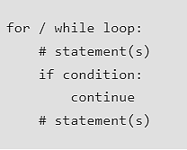
Continue
continue statement is opposite to that of the break statement, instead of terminating the loop, it forces to execute the next iteration of the loop.
As the name suggests the continue statement forces the loop to continue or execute the next iteration.
When the continue statement is executed in the loop, the code inside the loop following the continue statement will be skipped and the next iteration of the loop will begin.

Slide 15
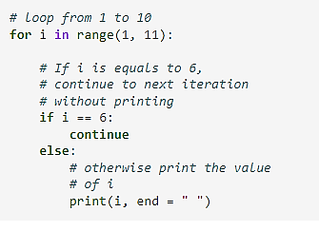

Slide 16

Pass
As the name suggests pass statement simply does nothing. The pass statement in Python is used when a statement is required syntactically but you do not want any command or code to execute.
It is like a null operation, as nothing will happen if it is executed. Pass statements can also be used for writing empty loops. Pass is also used for empty control statements, functions, and classes.

Slide 17
